Slide 1
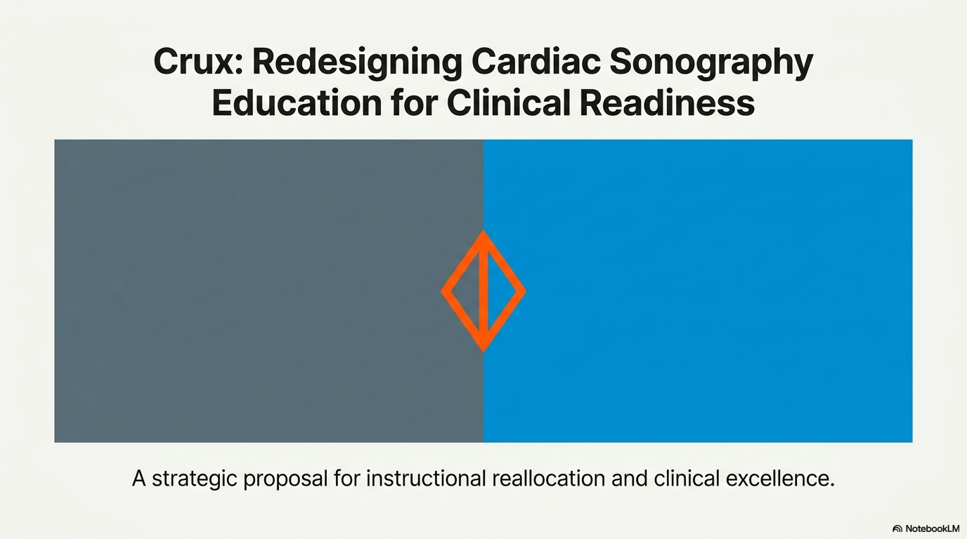

Slide 2
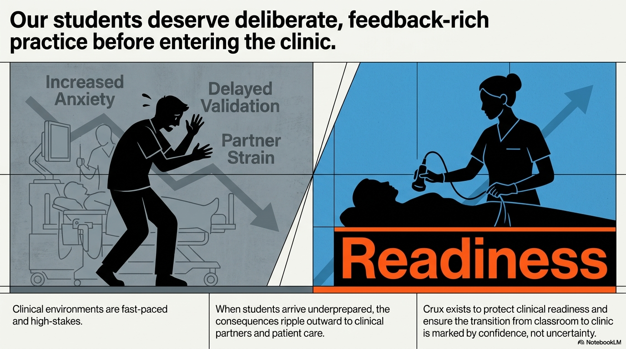

Slide 3
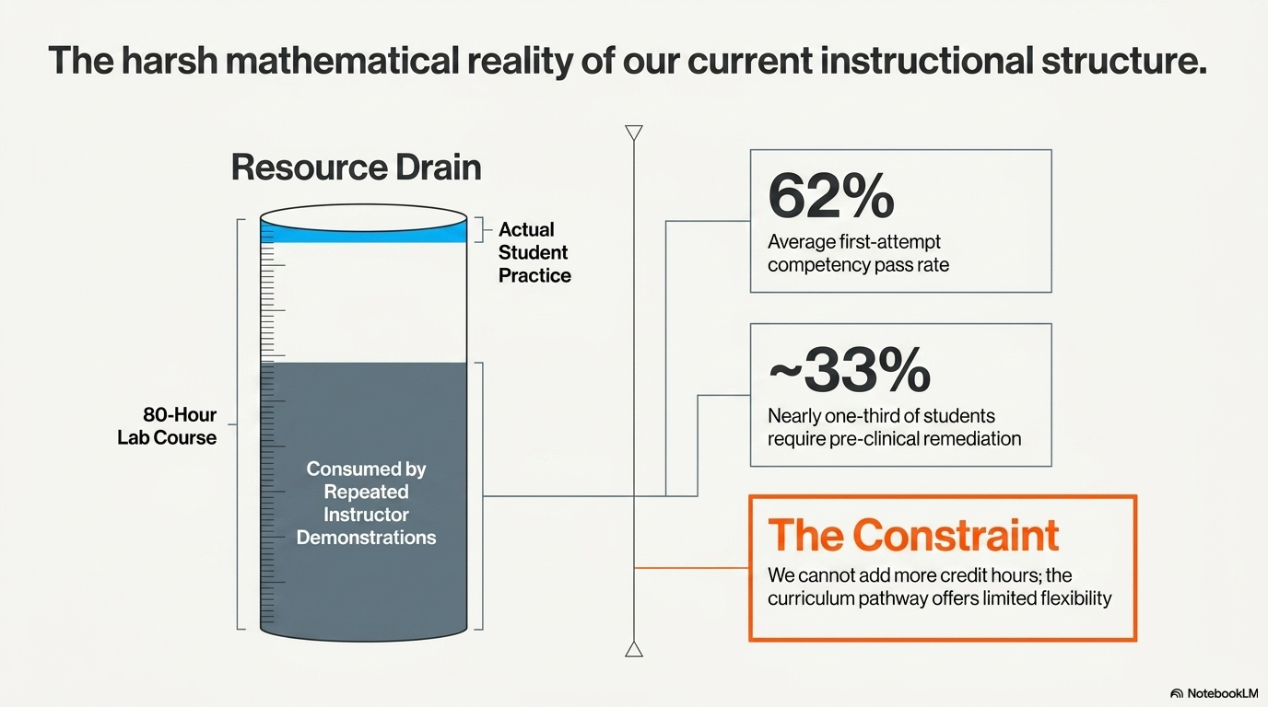

Slide 4
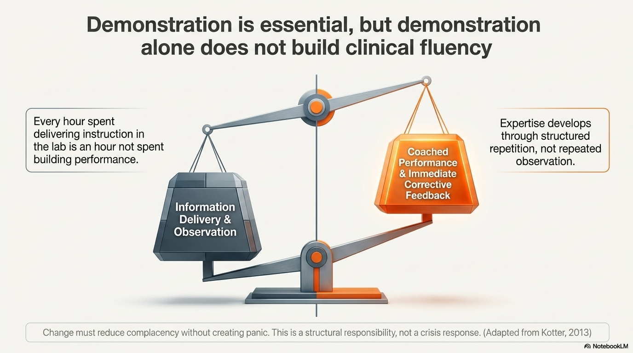

Slide 5
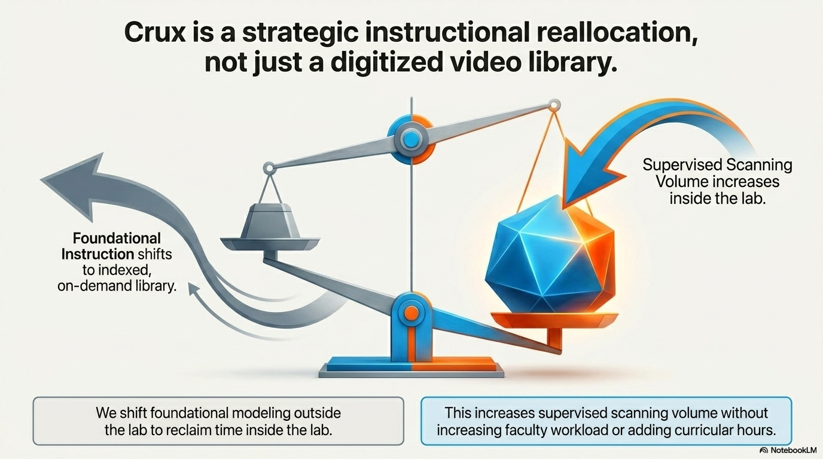

Slide 6
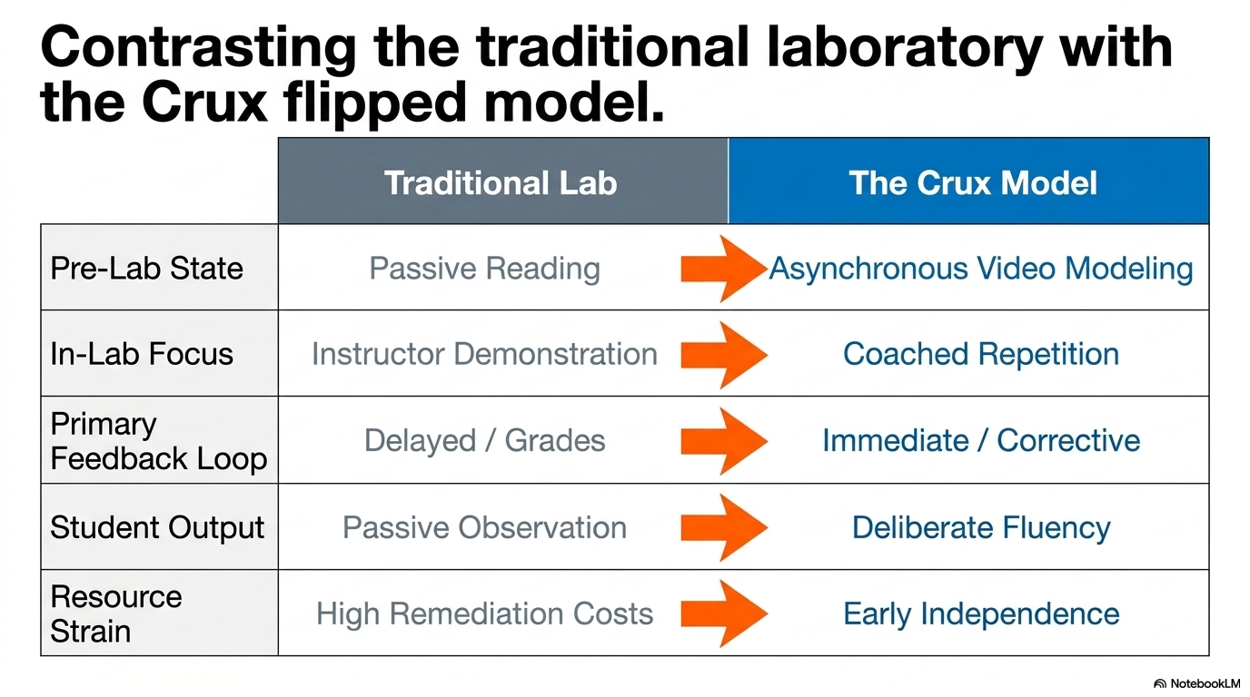

Slide 7
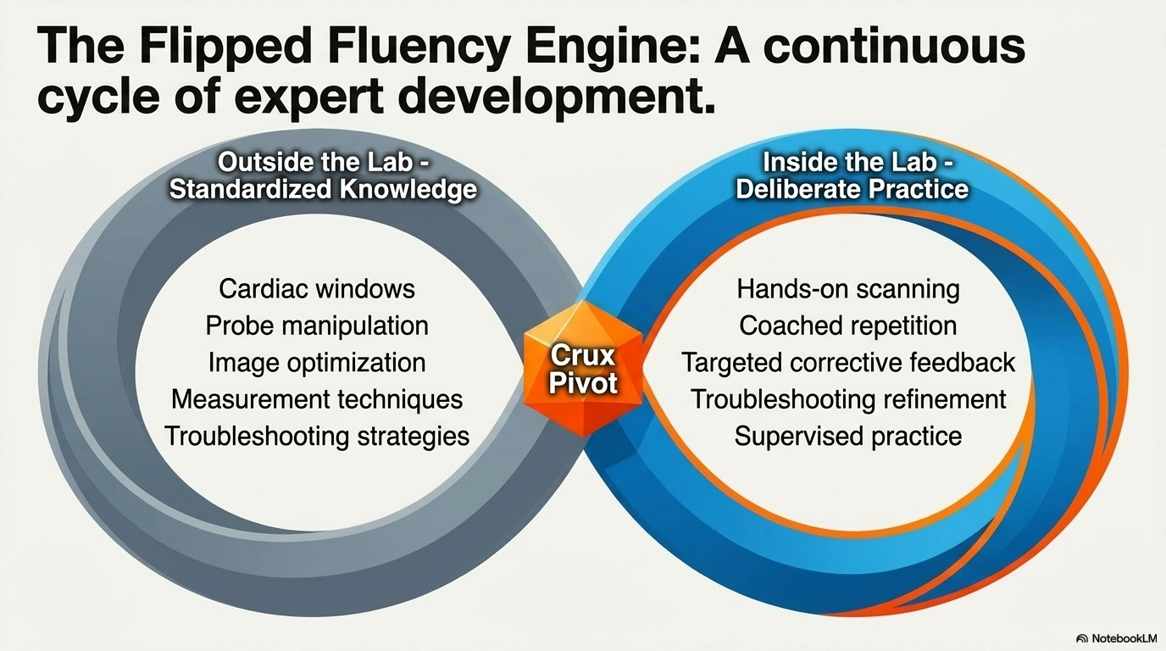

Slide 8
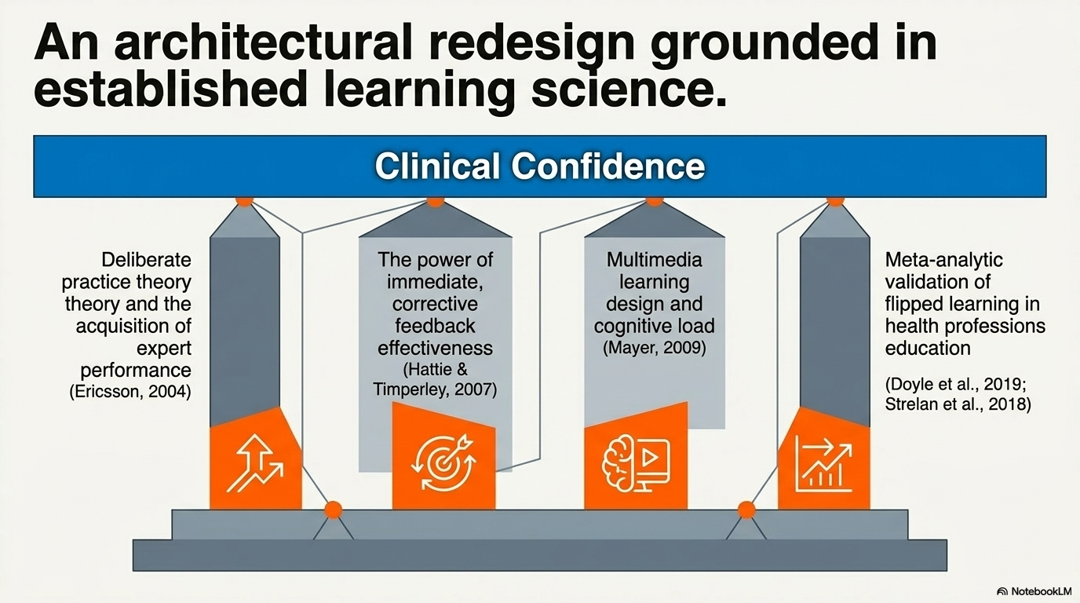

Slide 9
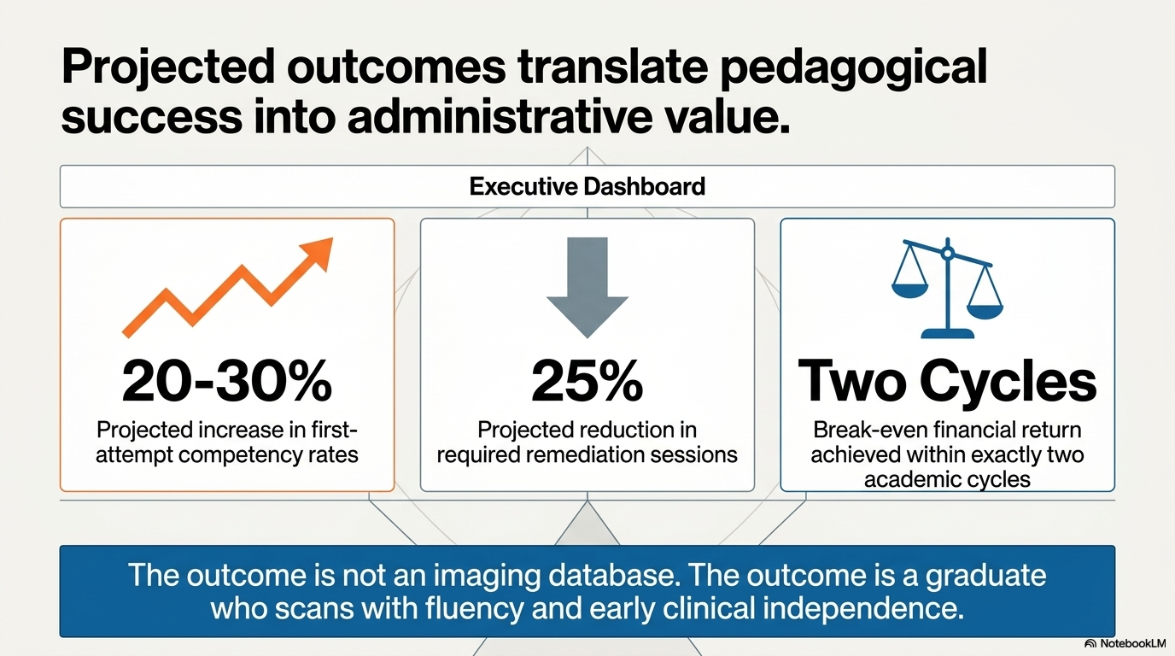

Slide 10
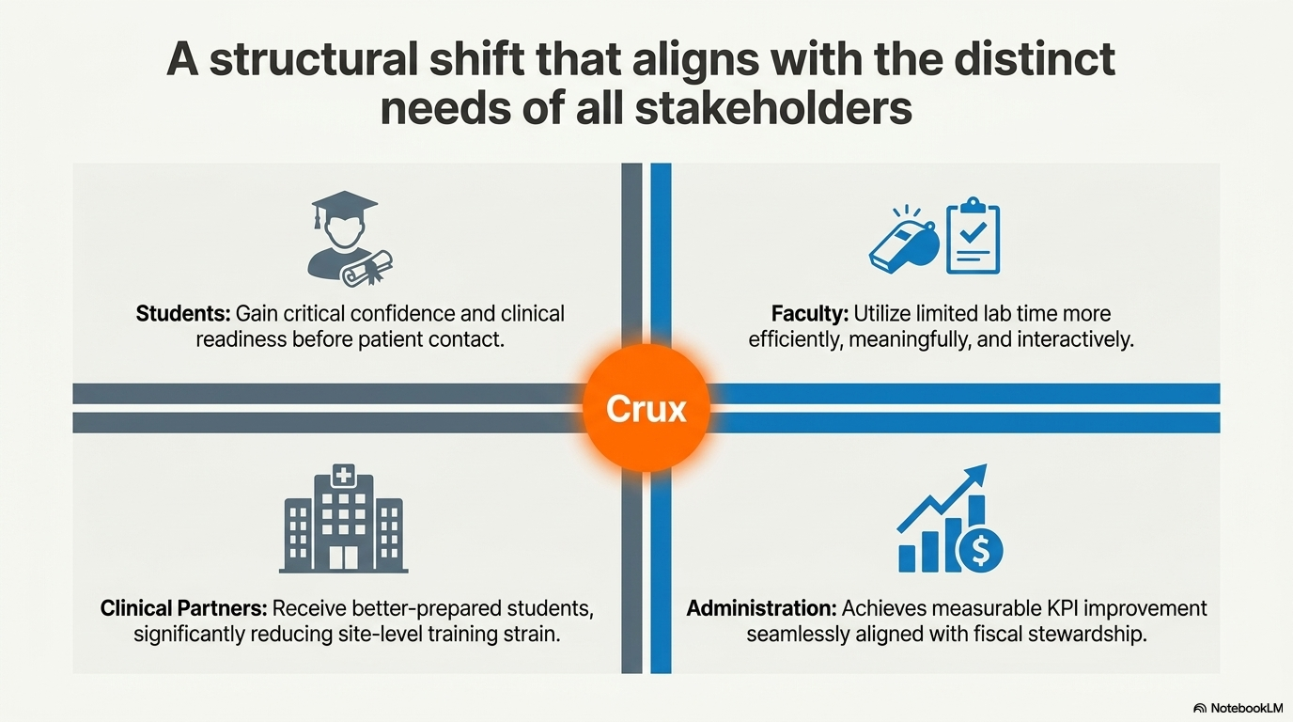

Slide 11
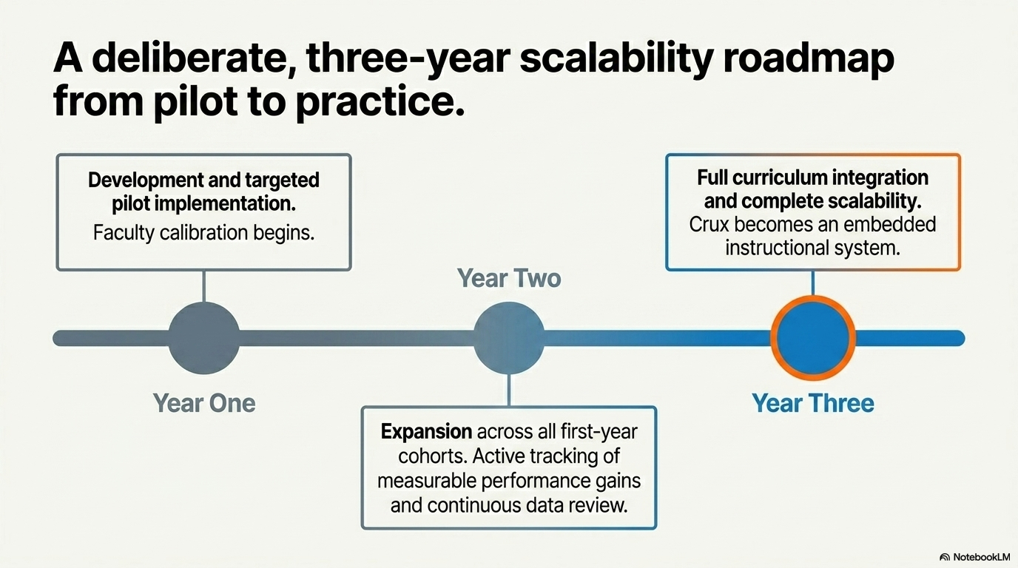

Slide 12
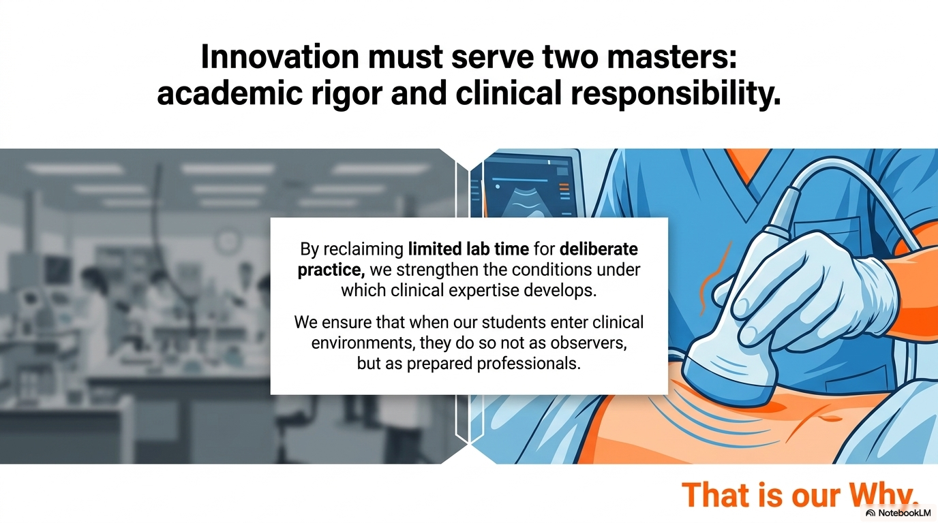

Slide 13
REFERENCES
Ericsson, K. A. (2004). Deliberate practice and the acquisition and maintenance of expert performance in
medicine and related domains. Academic Medicine, 79(10), S70–S81.
Hattie, J., & Timperley, H. (2007). The power of feedback. Review of Educational Research, 77(1), 81–112.
Doyle, J., Petkovic, K., & Rogers, G. (2019). Flipped classroom improves student learning in health profession
education: A meta‑analysis. BMC Medical Education, 19, 415.
Kotter, J. (2013). Leading change: Establish a sense of urgency [Video]. YouTube.
Mayer, R. E. (2009). Multimedia learning (2nd ed.). Cambridge University Press.
Sinek, S. (2009). How great leaders inspire action [Video]. TED Conferences.
Strelan, P., Osborn, A., & Palmer, E. (2018). The flipped classroom: A meta‑analysis of effects on student
performance across disciplines. Educational Research Review, 24, 1–15.

